Slide 1
Mixed-Integer Linear Programming Algorithm for a Computational Protein
Design Problem
Yushan Zhu
Ind. Eng. Chem. Res. 2007, 46, 839-845
Speaker: Chun-Jen Chen
Date: Apr. 8, 2009

Slide 2
Abstract
The computational protein design problem or the side-chain positioning problem is a central part in computational methods for predicting protein structure and designing protein sequences. However, the computational protein design problem is NP-complete, and it is also NP-complete to find a reasonable approximate solution to this problem. Here, we present a critical finding that the network flow structure embedded in the integer linear programming formulation of the computational protein design problem makes it equivalent to a mixed-integer linear programming formulation with fewer binary variables.
115/11/07

Slide 3
Abstract
This novel formulation effectively reduces the combinatorial difficulty of the computational protein design problem, thereby allowing the sequence selection of the global minimum energy conformation for large proteins to become tractable by using the standard optimization algorithms. Our preliminary calculation results for 20 core redesigned proteins show that the mixed-integer linear programming algorithm with a validated physical model is faster than its integer linear programming counterpart by up to 3 times. More importantly, the specific mathematical structure underlying the mixed-integer linear programming formulation paves the way for developing even faster combinatorial searching strategies by using stronger cutting planes for mixed-integer programming.
115/11/07

Slide 4
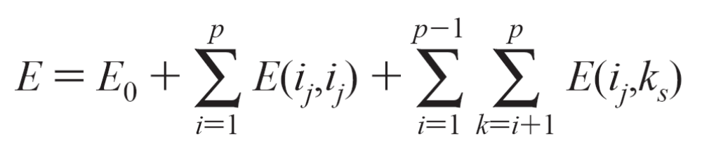
Computational Protein Design Problem
Given a fixed template, which consists of the protein backbone and the side chains of residue positions not to be optimized, with p optimized residue side chains, each optimized position i is associated with a set of candidate rotamers {i_{j}} coming from the same or different amino acids. Once a particular rotamer at each residue position has been chosen, the potential energy of a protein system can be written as:
115/11/07

Slide 5

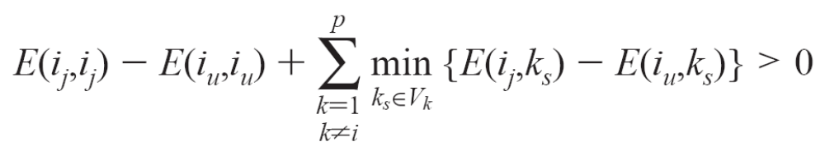
Dead-End Elimination Theorem
In this paper, the Goldstein DEE criterion16 is run as a filter for the mixed-integer linear programming algorithm, which says that a rotamer i_{j} V_{i}, where V_{i} includes all rotamers at position i, can be eliminated if there is another rotamer i_{u} V_{i} such that
115/11/07

Slide 6
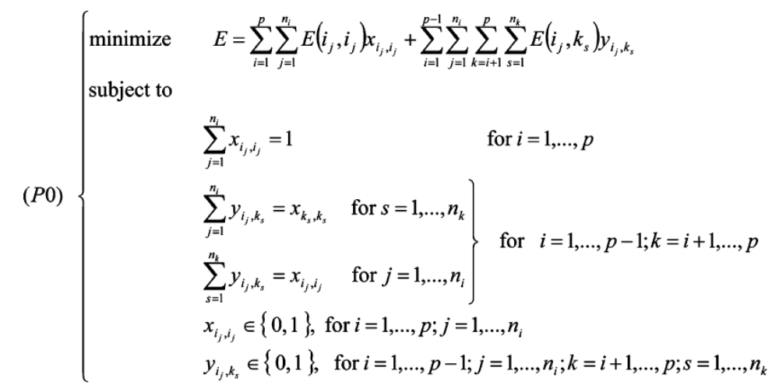
Integer Linear Programming Formulation
115/11/07

Slide 7
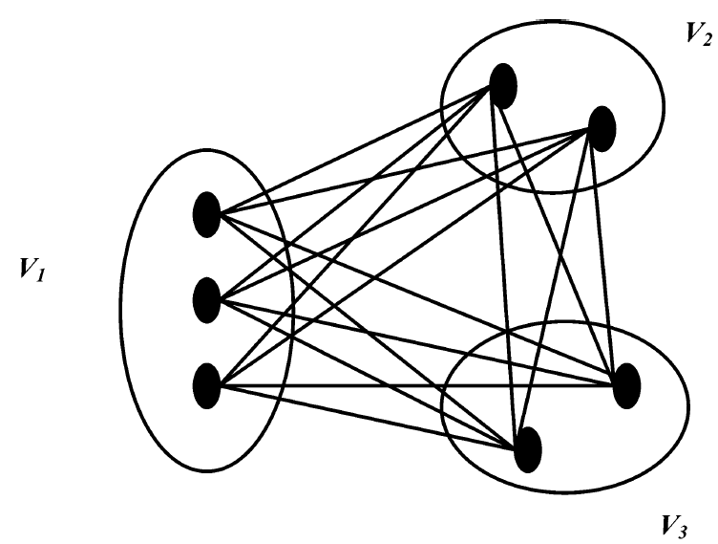
115/11/07

Slide 8
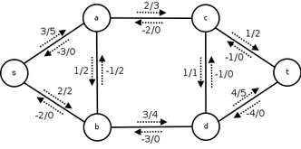
The Network Flow Problem
115/11/07

Slide 9
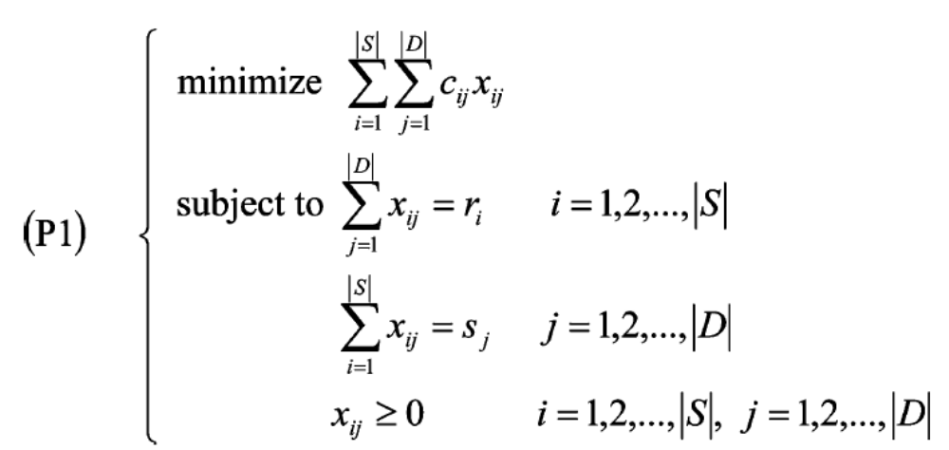
Mixed-Integer Linear Programming Formulation
A matrix N is said to be totally unimodular if every square submartix of N has a determiant of +1, -1, or 0.
For network flow problems with this property, the basic primal solutions are computed without any multiplications or divisions in the simplex algorithm, so we have the following integrality theorem.
115/11/07

Slide 10
Theorem 1.^{26,27} For network flow problems (P1) with integer data, every basic feasible solution and, in particular, every basic optimal solution assigns integer flow to every edge.
By virtue of this theorem, the following theorem ensures that a mixed-integer linear programming formulation is equivalent to the integer programming formulation (P0) for the computational protein design problem.
115/11/07

Slide 11
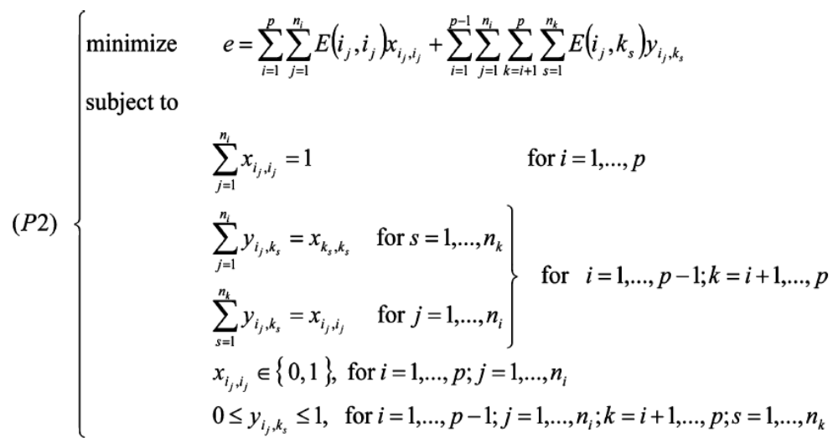
Theorem 2. The integer programming formulation (P0) of the computational protein design problem is equivalent to the following mixed-integer linear programming formulation, described by
115/11/07

Slide 12

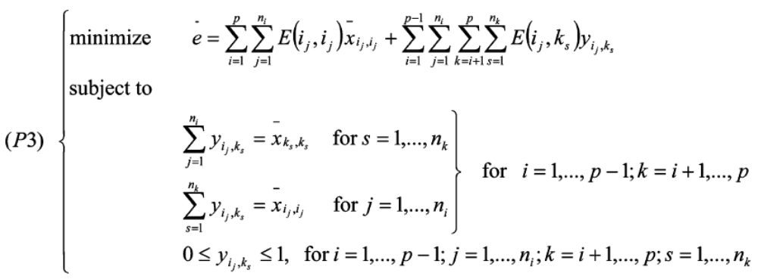
Proof. Let the minimum values of problems (P0) and (P2) be E* and e*. We have e* <= E* by observing that problem (P2) is a relaxation problem of problem (P0) since the integrality constraints on the edge variables are dropped. Assuming that is any combination of 0 and 1 satisfying the first set of constraints in problem (P2), we have
115/11/07

Slide 13
The first term of the objective function is constant.
Since the edge variables at different pair residue positions i and k are separable, so problem (P3) can be decomposed into p(p - 1)/2 Hitchcock transportation problems.
It is also not difficult to confirm that the coefficient matrix of problem (P3) is totally unimodular by observing that each edge variable just appears in two different rows in the constraint matrix of problem (P3).
115/11/07

Slide 14
According to the assumption on , the right-hand side of problem (P3) has integral data, and by virtue of theorem 1, the optimal solution of problem (P3) assigns integer to each edge variable.
Since our choice of represents all feasible combinations of 0 and 1 for problem (P2), we conclude that the minimum solution of problem (P2), i.e., (x*,y*), is integral. So, (x*,y*) is also a feasible solution to problem (P1). By virtue of e* <= E*, we conclude that problem (P2) has the same optimal solution as that of problem (P0).
115/11/07

Slide 15
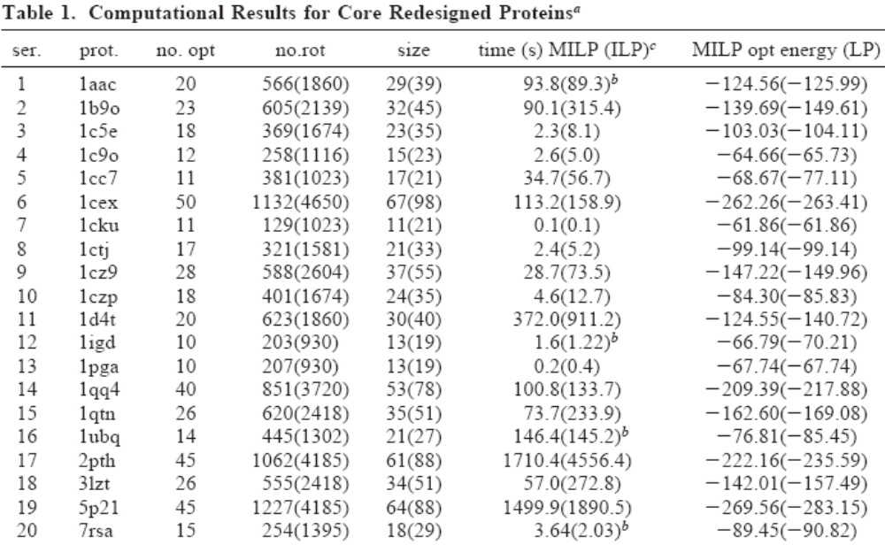
The proposed MILP performs poorly because CPLEX uses different heuristics for MILP and ILP.
115/11/07

